Slide 1
EMPLOYEE SALARY ANALYSIS USING EXCEL
STUDENT NAME: RAJESHWARI G
COLLEGE REGISTER NO:312208749
REGISTER NO: 42458CD12E193FB9003415E0FB80BDBA
DEPARTMENT: III B.COM (GENERAL),E2
COLLEGE: MEENAKSHI COLLEGE FOR WOMEN

Slide 2

PROJECT TITLE :
EMPLOYEE SALARY ANALYSIS AND ANALYSIS OF OVERALL COUNT OF EMPLOYEES IN EACH DEPARTMENT USING EXCEL.

Slide 3

AGENDA :
Problem Statement
Project Overview
End Users
Our Solution and Proposition
Dataset Description
Modelling Approach
Results and Discussion
Conclusion
3/21/2024 Annual Review

Slide 4

PROBLEM STATEMENT:
DUE TO LACK OF EMPLOYEE, THE SALES PERCENTAGE WAS DECREASED IN THE BUSINESS.
ANALYSE THE EMPLOYEE COUNTS IN EACH DEPEARTMENTS AND MOVING OR HIRING THE EMPLOYEES ACCORDINGLY.

Slide 5

PROJECT : MAIN OBJECTIVE OVERVIEW: -> TO ANALYSE THE DATA OF COUNTS OF EMPLOYEES IN EACH DEPARTMENT. -> TO ANALYSE THE LEAST COUNT OF EMPLOYEES ON EACH DEPARTMENT. -> TO HIRE NEW EMPLOYEES FOR THE DEPARTMENT WHICH CARRIES LOWEST COUNT OF EMPLOYEES.

Slide 6

WHO ARE THE END USERS: HERE,THE END USERS ARE THE ORGANISATION AND THE JOB SEEKERS,BECAUSE OF THIS PROJECT AIMS AT SOLVING THE PROBLEM OF LACK OF SALES BY HIRING NEW EMPLOYEES IN SALES DEPARTMENT AND THIS MAKES OPPURTUNITIES FOR THE JOB SEEKERS FOR THE EMPLOYMENT IN THE ORGANISATION AND INCREASE THE SALES.

Slide 7

OUR SOLUTION AND ITS VALUE PROPOSITION: THE PROBLEM IS THAT THE LEAST NUMBER OF EMPLOYEES IN THE SALES DEPARTMENT,IT CAUSE DECREASE IN SALES.THE SOLUTION FOR THIS PROBLEM FROM ANALYSING THE DEPARTMENTAL EMPLOYEE COUNTS IS HIRING NEW EMPLOYEES IN THE SALES DEPARTMENT.THIS WOULD CREATE MORE SALES ACTIVITIES IN THE ORGANISATION.

Slide 8
DATA DESCRIPTION: -> THIS PROJECT IS ANALYSED USING EXCEL .THE NECESSARY DATA OF THE DEPARTMENTAL EMPLOYEES IS FINALISED USING EXCEL. -> FROM THE COLLECTED DATA,ANALYSED THE CAUSE OF THE PROBLEM THAT THE LOWEST NUMBER OF EMPLOYEES ARE WORKING IN SALES DEPARTMENT.THEREFORE,THE SALES WAS DECREASED IN ORGANISATION. -> THE SALARY DATA OF THE EMPLOYEES ARE ANALYSED ON THE BASIS OF THEIR DEPARTMENTS TO ANALYSE THE OVERALL LEAST SALARY IN WHICH DEPARTMENT. -> SO,IN THIS DATA,THE OVERALL DECREASED EMPLPOYEES IN WHICH DEPARTMENT AND THEIR SALARIES WERE ANALYSED IN DEPARTMENTAL WISE.

Slide 9

THE "WOW" IN OUR SOLUTION : ANALYSED THE CAUSE OF LEAST COUNT OF SALES IN THE ORGANISATION.SO,THIS HELPS TO SOLVE THE LOW SALES BY HIRING NEW EMPLOYEES TO THE ORGANISATION TO INCREASE THE PERCENTAGE OF SALES IN SALES DEPARTMENT.
‹#›

Slide 10
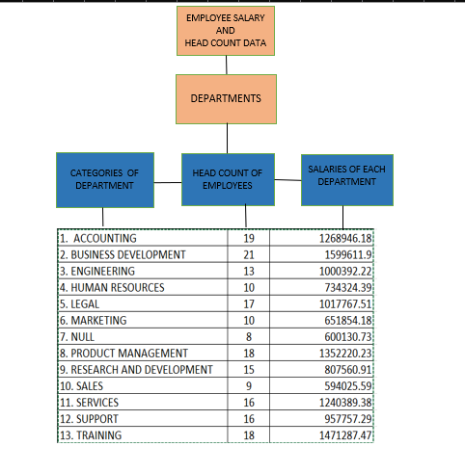
MODELLING :
BELOW MODEL REPRESENTS THE DATA OF EMPLOYEE SALARY AND HEAD COUNT DATA UNDER THE HEAD OF DEPARTMENT ALONG WITH THREE CATEGORIES.
‹#›

Slide 11
RESULTS :
TABLE SHOWING THE TOTAL COUNTS OF EMPLOYEES AND TOTAL OF SALARIES ON THE BASIS OF DEPARTMENTS.
DEPARTMENTS | Count of Employees | Sum of Salary
Accounting | 19 | 1268946.18
Business Development | 21 | 1599611.9
Engineering | 13 | 1000392.22
Human Resources | 10 | 734324.39
Legal | 17 | 1017767.51
Marketing | 10 | 651854.18
NULL | 8 | 600130.73
Product Management | 18 | 1352220.23
Research and Development | 15 | 807560.91
Sales | 9 | 594025.59
Services | 16 | 1240389.38
Support | 16 | 957757.29
Training | 18 | 1471287.47
Grand Total | 190 | 13296267.98
‹#›

Slide 12
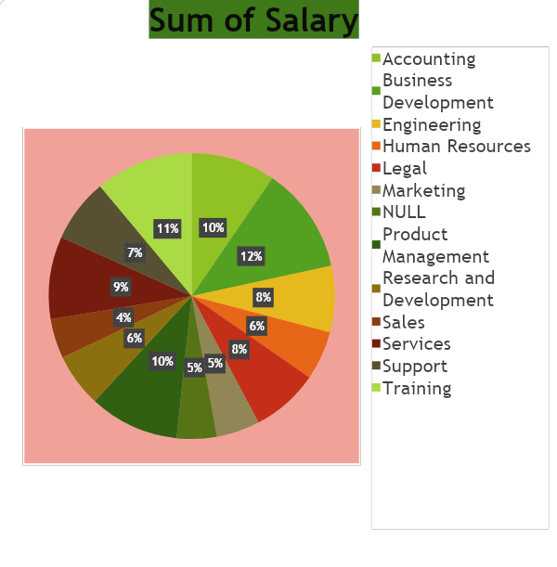
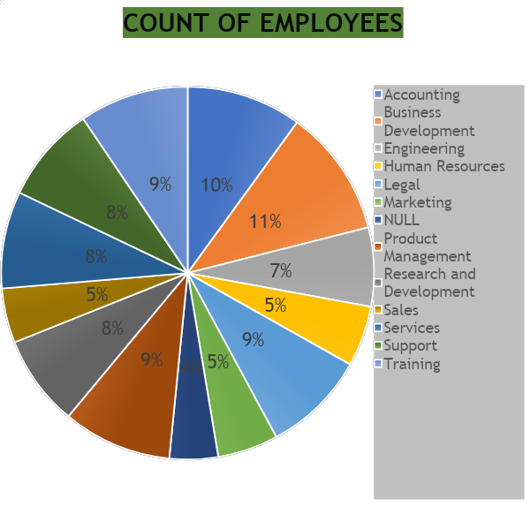
VISUAL REPRESENTATION :
PIE CHART

Slide 13
-> IN THIS DATA ANALYSIS ,THE LOW SALES WERE IDENTIFIED, BECAUSE OF LOW EMPLOYEES. -> FOR THIS PROBLEM, ALSO GOT SOLUTION AS HIRING NEW EMPLOYEES IN SALES DEPARTMENT TO THE ORGANISATION TO INCREASE SALES. -> ALSO ANALYSED THE SALARIES OF THE DEPARTMENTAL EMPLOYEES FOR THE PAY ROLL -> THE ABOVE PIE CHARTS SHOWS THE PERCENTAGE OF SALARIES AND PERCENTAGE OF COUNT OF OVERALL DEPARTMENTAL EMPLOYEES
CONCLUSION :

